Slide 1
Deep Reinforcement Learning
Deep Learning: Bryan Pardo, Northwestern University, Fall 2020

Slide 2
Learning Types
Supervised learning:
(Input, output) pairs of the function to be learned are given (e.g. image labeling)
Unsupervised Learning:
No human labels provided (e.g. language modeling, image reconstruction)
Reinforcement learning:
Reward or punishment for actions (winning or losing a game)

Slide 3
Reinforcement Learning
Task
Learn how to behave to achieve a goal
Learn through experience from trial and error
Examples
Game playing: The agent knows when it wins, but doesn’t know the appropriate action in each state along the way
Control: a traffic system can measure the delay of cars, but not know how to decrease it.

Slide 4
Basic RL Model
Observe state, s_{t}
Decide on an action, a_{t}
Perform action
Observe new state, s_{t+1}
Observe reward, r_{t+1}
Learn from experience
Repeat
Goal: Find a control policy that will maximize the observed rewards over the lifetime of the agent
World
S
R
A

Slide 5
A Cannonical Example: Gridworld
States are grid cells
4 actions: N, S, E, W
Reward for entering top right cell
-0.01 for every other move
+1

Slide 6
The Markov Property
RL needs a set of states that are Markov
Everything you need to know to make a decision is included in the state
Not allowed to consult the past
Rule-of-thumb
If you can calculate the reward function
from the state without any additional
information, you’re OK
Not holding key
Holding key
K
S
G

Slide 7
We need some background
Simple decision theory
Markov Decision Processes
Value functions
Dynamic programming

Slide 8
Making Single Decisions
Single decision to be made
Multiple discrete actions
Each action has an associated reward
Goal is to maximize reward
Just pick the action with the largest reward
State 0 has a value of 2
Reward from taking the best action
1
1
0
2
2

Slide 9
Markov Decision Processes
We can generalize the previous example to multiple sequential decisions
Each decision affects subsequent decisions
This is formally modeled by a Markov Decision Process (MDP)
A
3
1
A
1
1
1
A
B
0
1
5
B
2
-1000
10
2
A
4
A

Slide 10
Markov Decision Processes
Formally, a MDP is
A set of states, S = {s₁, s₂, ... , s_{n}}
A set of actions, A = {a₁, a₂, ... , a_{m}}
A reward function, R: S×A×S→ℜ
A transition function,
Sometimes T: S×A→S
We want to learn a policy, π: S →A
Maximize sum of rewards we see over our lifetime

Slide 11
Policies
A policy π(s) returns the action to take in state s.
There are 3 policies for this MDP
Policy 1: 0 →1 →3 →5
Policy 2: 0 →1 →4 →5
Policy 3: 0 →2 →4 →5
A
3
1
A
1
1
1
A
B
0
1
5
B
2
-1000
10
2
A
4
A

Slide 12
Comparing Policies
Which policy is best?
Order them by how much reward they see
Policy 1: 0 →1 →3 →5 = 1 + 1 + 1 = 3
Policy 2: 0 →1 →4 →5 = 1 + 1 + 10 = 12
Policy 3: 0 →2 →4 →5 = 2 – 1000 + 10 = -988
A
3
1
A
1
1
1
A
B
0
1
5
B
2
-1000
10
2
A
4
A

Slide 13
Value Functions
s’ is the
next state
a’ is the
next action
For a given policy, we can associate a value with each state
How good is it to run policy π from that state s?
This is the state value function, V
V¹(s₁) = 2
V²(s₁) = 11
How do you tell which
policy to follow from
each state?
V¹(s₀) = 3
V²(s₀) = 12
V³(s₀) = -988
V¹(s₃) = 1
A
3
1
A
1
1
1
A
B
0
1
5
B
2
-1000
10
2
4
A
A
V²(s₄) = 10
V³(s₄) = 10
V³(s₂) = -990
V^{π}(s) = R(s, π(s), s’) + V^{π}(s’)

Slide 14
Q Functions
s’ is the
next state
a’ is the
next action
Define value without specifying the policy
It is the value of taking action A from state S and then performing optimally, thereafter
Q(1, A) = 2
Q(1, B) = 11
Q(3, A) = 1
Q(0, A) = 12
Q(0, B) = -988
A
3
1
A
1
1
1
A
B
0
1
5
B
2
-1000
10
2
A
4
A
Q(2, A) = -990
Q(4, A) = 10
Q(s, a) = R(s, a, s’) + max_{a’} Q(s’, a’)

Slide 15
Value Functions
These can be extended to probabilistic actions
(for when the results of an action are not certain, or when a policy is probabilistic)

Slide 16
Getting the Policy
If we have the value function, then finding the optimal policy, π∗(s), is easy…just find the policy that maximized value
π∗(s) = arg max_{a} (R(s, a, s’) + V^{π}(s’))
π∗(s) = arg max_{a} Q(s, a)

Slide 17
Learning Policies Directly
Run whole policy, then receive a single reward
Reward measures success of the whole policy
If there are a small number of policies, we can exhaustively try them all
This is not possible in most interesting problems

Slide 18
Problems with Our Functions
Consider this MDP
Number of steps is now unlimited because of loops
Value of states 1 and 2 is infinite for some policies
Q(1, A) = 1 + Q(1, A)
Q(1, A) = 1 + 1 + Q(1, A)
Q(1, A) = 1 + 1 + 1 + Q(1, A)
Q(1, A) = ...
This is bad
All policies with a non-zero reward
cycle have infinite value
1
A
-1000
1
0
A
B
0
3
B
B
0
1000
2
A
1

Slide 19
Better Value Functions
Introduce the discount factor γ, to get around the problem of infinite value
Three interpretations
Probability of living to see the next time step
Measure of the uncertainty inherent in the world
Makes the mathematics work out nicely
Assume 0 ≤ γ ≤ 1
V^{π}(s) = R(s, π(s), s’) + γV^{π}(s’)
Q(s, a) = R(s, a, s’) + γmax_{a’} Q(s’, a’)

Slide 20
Better Value Functions
Value now depends
on the discount, γ
Optimal Policy:
π(0) = B
π(1) = A
π(2) = A
1
A
-1000
1
0
A
B
0
3
B
B
0
1000
2
A
1

Slide 21
Dynamic Programming
Given the complete MDP model, we can compute the optimal value function directly
V(1) = 1 + 10γ + 0γ²
V(3) = 1 + 0γ
A
3
1
A
V(5) = 0
1
1
1
A
B
0
1
5
0
B
A
2
-1000
10
V(0) = 1 + γ + 10γ² +0γ³
2
4
A
A
V(2) = - 1000 +10γ + 0γ²
V(4) = 10 + 0γ
[Bertsekas, 87, 95a, 95b]

Slide 22
Reinforcement Learning
What happens if we don’t have the whole MDP?
We know the states and actions
We don’t have the system model (transition function) or reward function
We’re only allowed to sample from the MDP
Can observe experiences (s, a, r, s’)
Need to perform actions to generate new experiences
This is Reinforcement Learning (RL)
Sometimes called Approximate Dynamic Programming (ADP)

Slide 23
Learning Value Functions
We still want to learn a value function
We’re forced to approximate it iteratively
Based on direct experience of the world
Four main algorithms
Certainty equivalence
TD λ learning
Q-learning
SARSA

Slide 24
How are we going to do this?
100
points
Reward whole policies?
That could be a pain
What about incremental rewards?
Everything has a reward of 0 except for the goal
Now what???
G
S

Slide 25
Exploration vs. Exploitation
We want to pick good actions most of the time, but also do some exploration
Exploring means we can learn better policies
But, we want to balance known good actions with exploratory ones
This is the exploration/exploitation problem

Slide 26
On-Policy vs. Off Policy
On-policy algorithms
Final policy is influenced by the exploration policy
Generally, the exploration policy needs to be “close” to the final policy
Can get stuck in local maxima
Off-policy algorithms
Final policy is independent of exploration policy
Can use arbitrary exploration policies
Will not get stuck in local maxima
Given enough
experience

Slide 27
Picking Actions
ε-greedy
Pick best (greedy) action with probability 1 - ε
Otherwise, pick a random action
Boltzmann (Soft-Max)
Pick an action based on its Q-value
…where τ is the “temperature”

Slide 28
TD(l)
TD-learning estimates the value function directly
Don’t try to learn the underlying MDP
Keep an estimate of V^{π}(s) in a table
Update these estimates as we gather more experience
Estimates depend on exploration policy, π
TD is an on-policy method
[Sutton, 88]

Slide 29
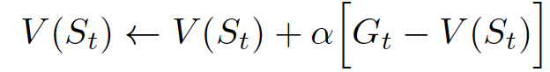
What are we learning here?
Approach 1: Run the policy until you see the final outcome, then update your value V(S). If G is the final outcome…then
Approach 2: Update as you go, using your existing estimate of state values as your proxy for the final reward

Slide 30
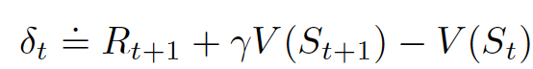
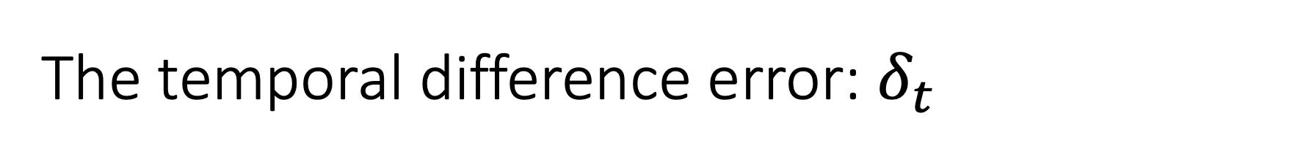
The temporal difference error: $δ_{t}$
This is the difference between our current estimate of this state’s value and our bootstrapped estimate of the value, now that we’ve taken an action according to a policy.

Slide 31
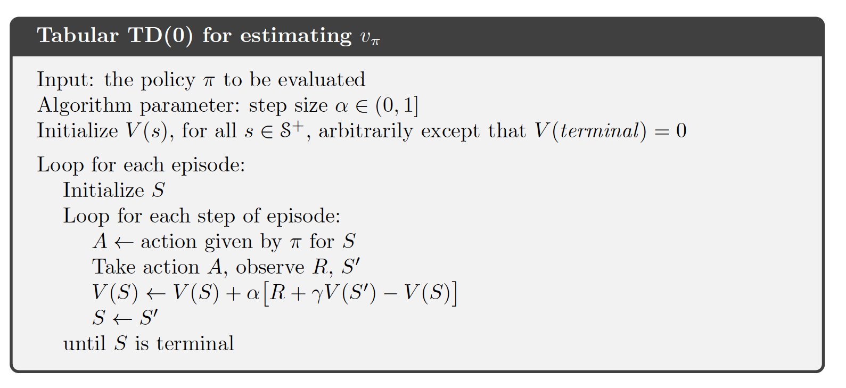
TD(0)-Learning Algorithm
R = reward
= learning rate
γ= discount factor
this formulation is from Sutton & Barto’s “Reinforcement Learning”

Slide 32
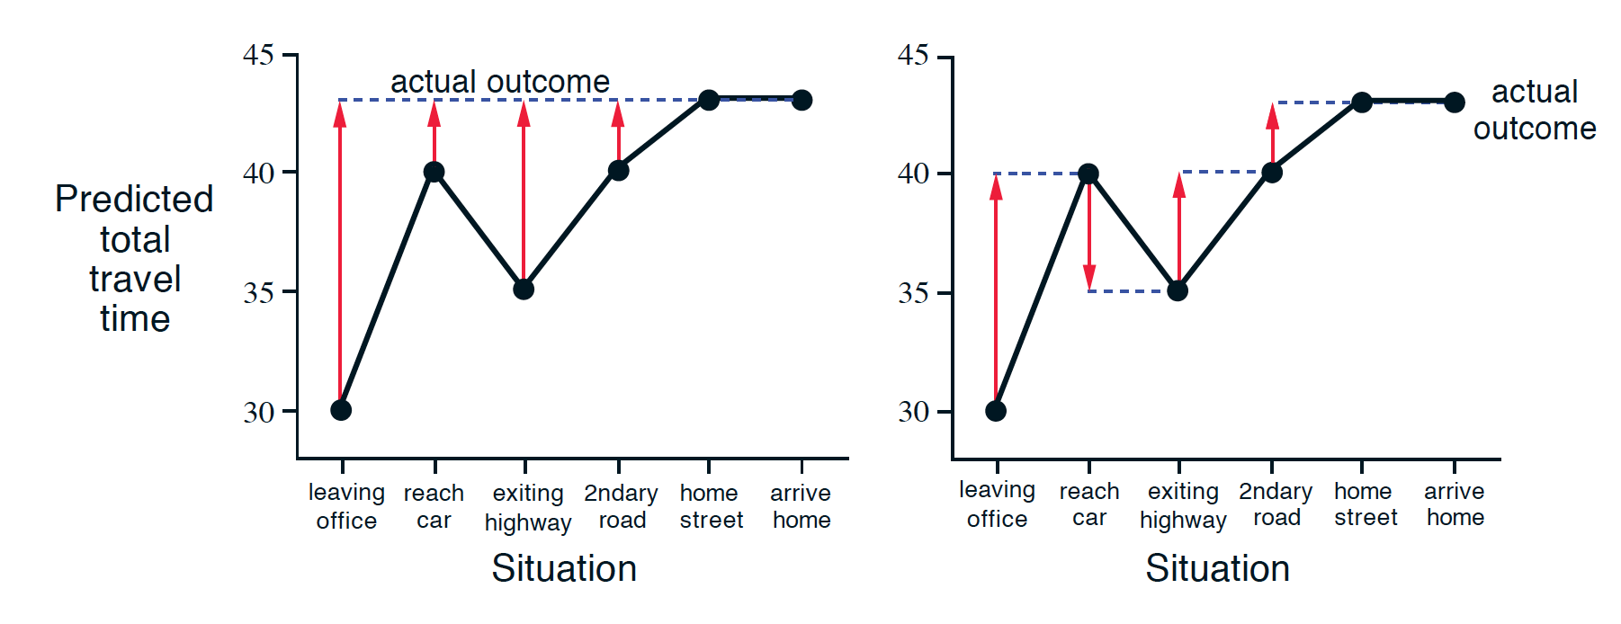
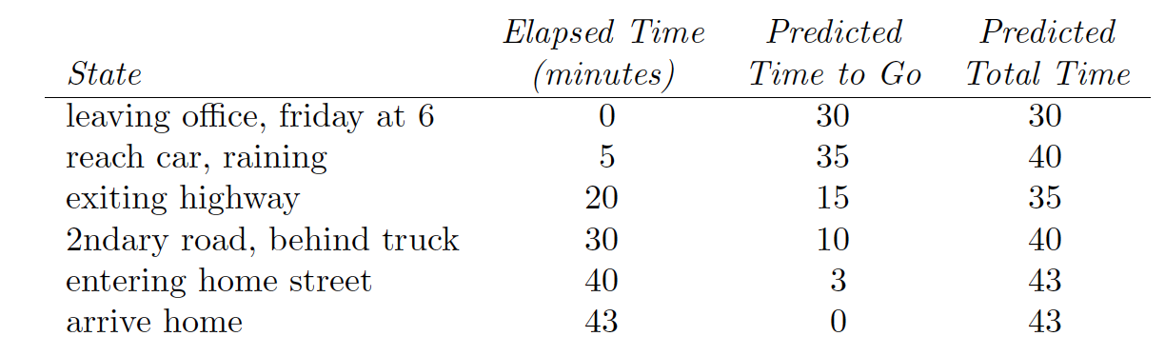
Driving example
(MC) Waiting till end
(TD) Updating incrementally

Slide 33
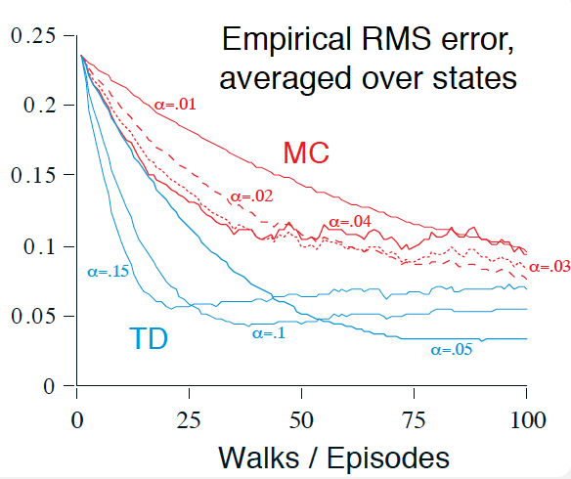
Why not wait till the end to do our update?

Slide 34
TD-Learning
V^{π}(s) is guaranteed to converge to V*(s)
After an infinite number of experiences
If we decay the learning rate
will work, where c is a constant and t is the step index
In practice, we often don’t need value convergence
Policy convergence generally happens sooner

Slide 35
What if we want to predict the action, not the state?
Replace our existing update as you go learning rule:
With one that updates the Q table instead of the V table:

Slide 36
SARSA
SARSA iteratively approximates the state-action value function, Q
L, SARSA learns the policy and the value function simultaneously
Keep an estimate of Q(s, a) in a table
Update these estimates based on experiences
Estimates depend on the exploration policy
SARSA is an on-policy method
Policy is derived from current value estimates

Slide 37
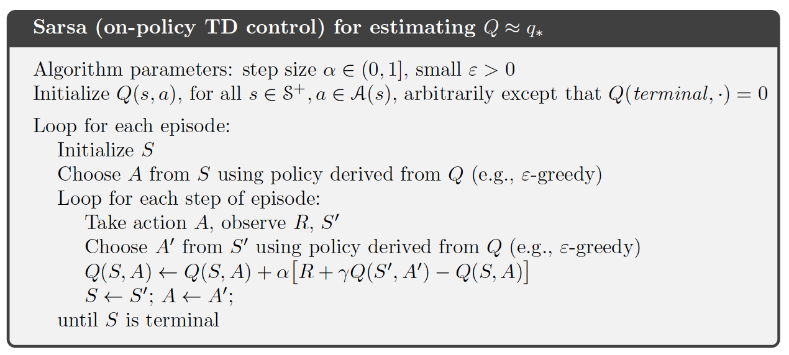
SARSA: The algorithm

Slide 38
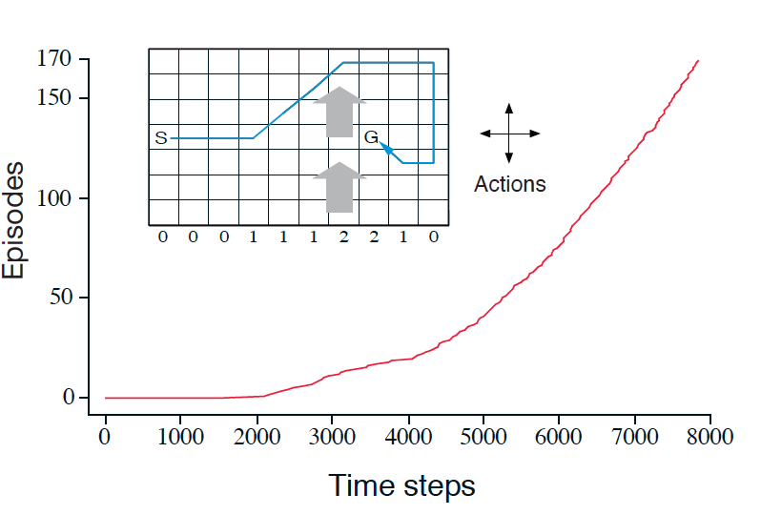
Windy Grid World
There is wind where there are arrows
Wind moves you 1 step up at each turn
This means there are some policies that will never terminate
Therefore you must learn the policy on-the-fly
You can’t just try all policies and wait till you see the final result

Slide 39
What if we want to learn the best action, regardless of current policy?
Replace our existing update to the Q table:
….with this:

Slide 40
Q-Learning
[Watkins & Dayan, 92]
Q-learning iteratively approximates the state-action value function, Q
We won’t estimate the MDP directly
Learns the value function and policy simultaneously
Keep an estimate of Q(s, a) in a table
Update these estimates as we gather more experience
Estimates do not depend on exploration policy
Q-learning is an off-policy method

Slide 41
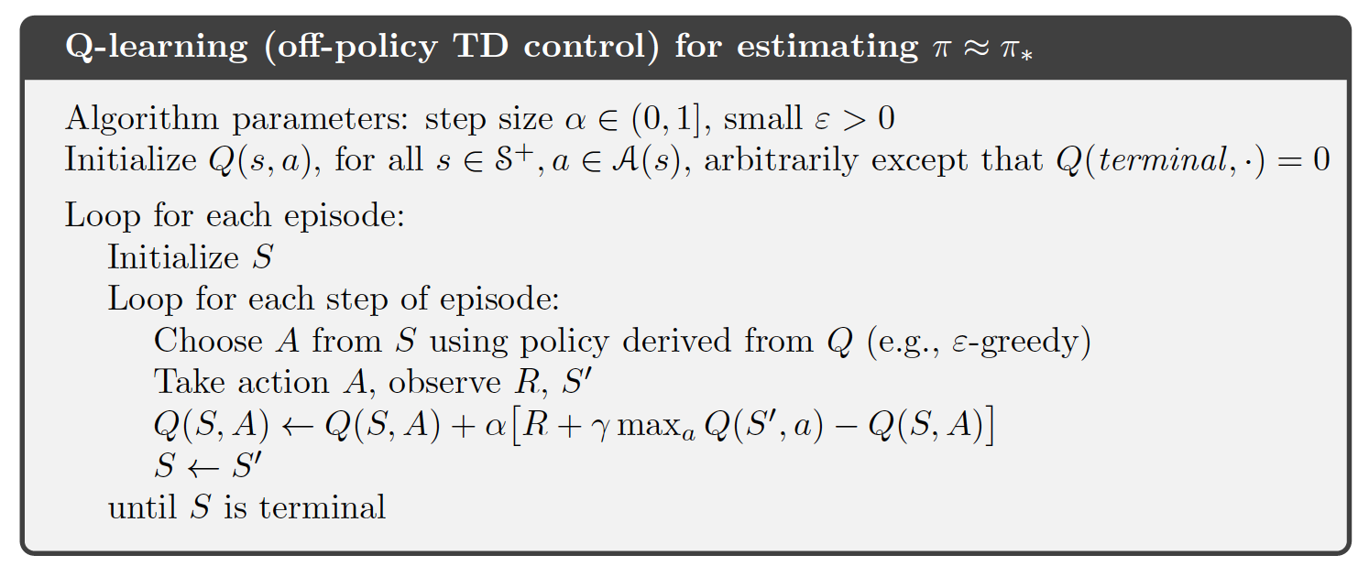
Q-Learning Algorithm
Initialize Q(s, a) to small random values, ∀s, a
(what if you make them 0? What if they are big?)
Observe state, s
Randomly (or ε greedy) pick action, a
Observe next state, s’, and reward, r
Q(s, a)←Q(s, a) + α(r + γmax_{a’}Q(s’, a’) – Q(s, a))
s ←s’
Go to 2
0 ≤ α ≤ 1 is the learning rate & we should decay α, just like in TD
Note: this formulation is from Sutton & Barto’s “Reinforcement Learning”

Slide 42
Breaking apart that update formula
Q(s, a)←Q(s, a) + α(R + γmax_{a’}Q(s’, a’) – Q(s, a))
This can be written another way…
Q(s, a)←(1- α )Q(s, a) + α(R + γmax_{a’}Q(s’, a’))
Looked at this way, it is more obvious that α controls whether we value past experience more or new experience more.

Slide 43
Q-learning
Q-learning, learns the expected utility of taking a particular action a in state s
0
100
0
90
100
0
0
G
90
100
G
0
72
81
G
0
81
0
0
0
0
0
81
81
90
90
100
100
0
0
81
90
100
72
81
r(state, action)
immediate reward values
V*(state) values
Q(state, action) values

Slide 44
Convergence Guarantees
The convergence guarantees for RL are “in the limit”
The word “infinite” crops up several times
Don’t let this put you off
Value convergence is different than policy convergence
We’re more interested in policy convergence
If one action is significantly better than the others, policy convergence will happen relatively quickly

Slide 45
Rewards
Rewards measure how well the policy is doing
Often correspond to events in the world
Current load on a machine
Reaching the coffee machine
Program crashing
Everything else gets a 0 reward
Things work better if the rewards are incremental
For example, distance to goal at each step
These reward functions are often hard to design
These are
sparse rewards
These are
dense rewards

Slide 46
Let’s talk state space & combinatorics
The idea is to learn a probability distribution over the set of actions possible at each state
We’ve assumed that there is a table of states and actions
How big could such a table get?

Slide 47
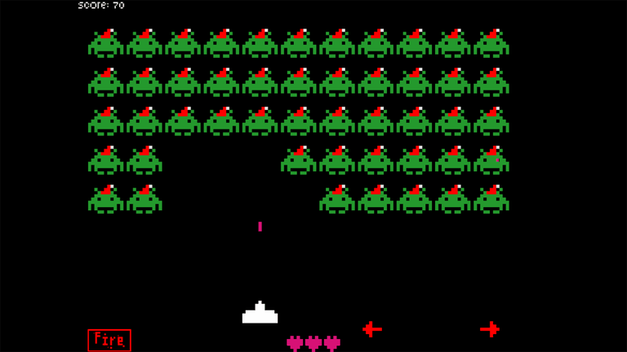
Playing Video Games
Mnih, V., Kavukcuoglu, K., Silver, D., Graves, A., Antonoglou, I., Wierstra, D., & Riedmiller, M. (2013). Playing atari with deep reinforcement learning. arXiv preprint arXiv:1312.5602.

Slide 48
We need to replace the table with….
…a parameterized function that can output the policy
Historically, this could be any function
These days it means…you guessed it…a deep net
...and this also means we need differentiable policy gradient

Slide 49
Policy Gradient Methods
Assume that our policy, p, has a set of n real-valued parameters, q = {q₁, q₂, q₃, ... , q_{n} }
Running the policy with a particular q results in a reward, r_{q}
Estimate the reward gradient, , for each q_{i}
This is another
learning rate

Slide 50
Policy Gradient Methods
This results in hill-climbing in policy space
So, it’s subject to all the problems of hill-climbing
But…we can also use tricks from search, like random restarts and momentum terms
This is a good approach if you have a parameterized policy
Typically faster than value-based methods
“Safe” exploration, if you have a good policy
Learns locally-best parameters for that policy

Slide 51
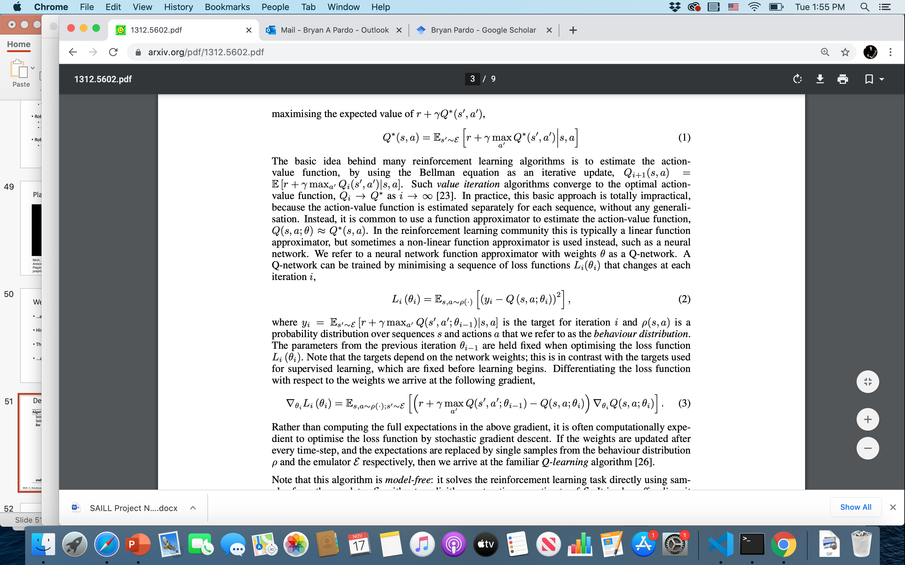
Going to a parameterized Q model
Take the standard Bellman equation for estimating the Q function:
Take a loss function for a parameterized function , where $y_{i}$is the target value and $θ_{i}$ are the parameters :
Take the gradient:
Mnih, V., Kavukcuoglu, K., Silver, D., Graves, A., Antonoglou, I., Wierstra, D., & Riedmiller, M. (2013). Playing atari with deep reinforcement learning. arXiv:1312.5602.

Slide 52
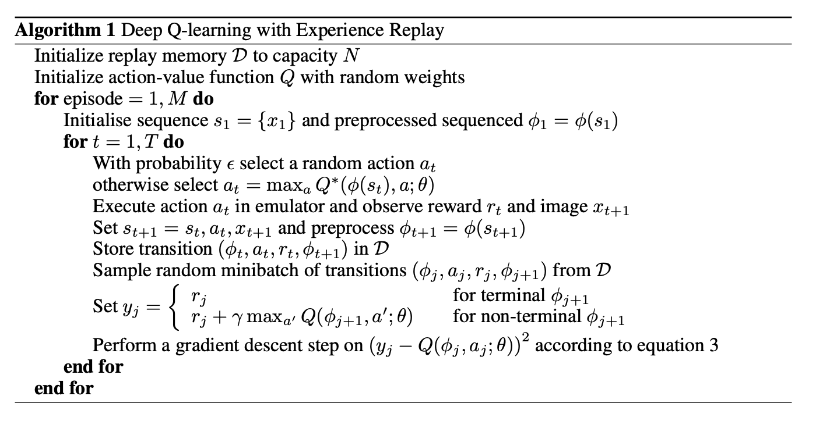
Deep Q-learning
Mnih, V., Kavukcuoglu, K., Silver, D., Graves, A., Antonoglou, I., Wierstra, D., & Riedmiller, M. (2013). Playing atari with deep reinforcement learning. arXiv:1312.5602.

Slide 53
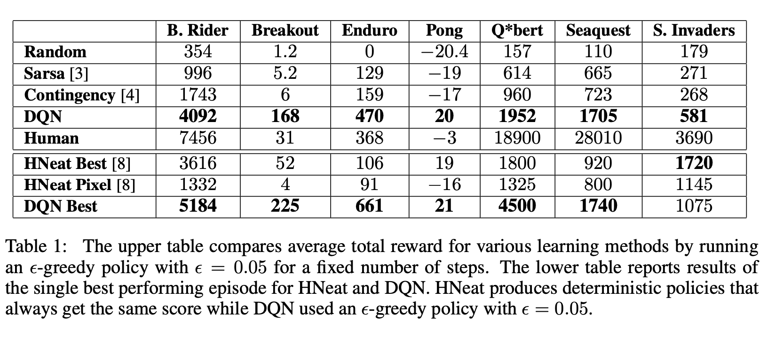
This was a breakthrough
Mnih, V., Kavukcuoglu, K., Silver, D., Graves, A., Antonoglou, I., Wierstra, D., & Riedmiller, M. (2013). Playing atari with deep reinforcement learning. arXiv:1312.5602.

Slide 54
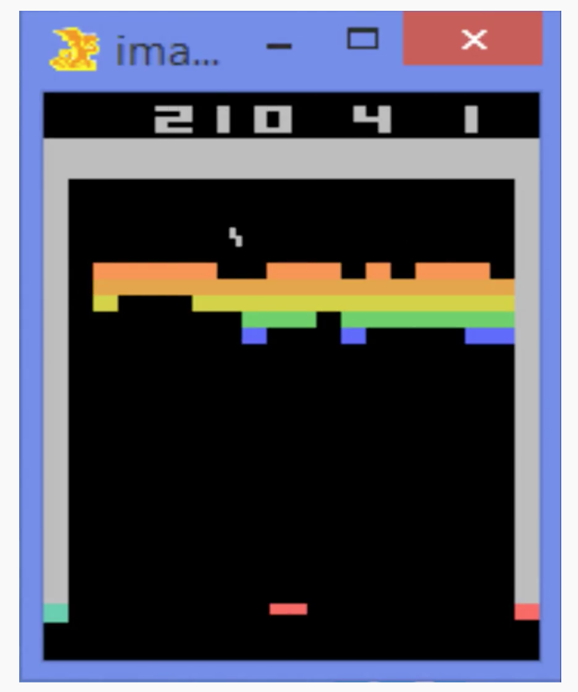
Let’s watch!
https://www.youtube.com/watch?v=V1eYniJ0Rnk

Slide 55
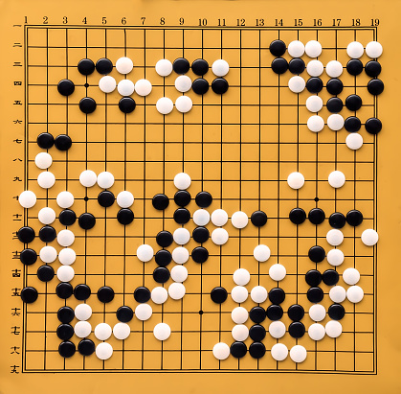
The game of GO
19 by 19 board
Each position is either empty, white, or black
At each turn you can place a stone of your color on any empty position
How big would the Q table be for this world?
Image Creator: Zozulya | Credit: Getty Images/iStockphoto

Slide 56
AlphaGO
2015: First program to beat a professional Go master with no handicap
2017: Beat Ke Jie, the number one ranked player in the world at the time
Silver, David, et al. "Mastering the game of Go with deep neural networks and tree search." nature 529.7587 (2016): 484-489
Image Creator: Zozulya | Credit: Getty Images/iStockphoto

Slide 57
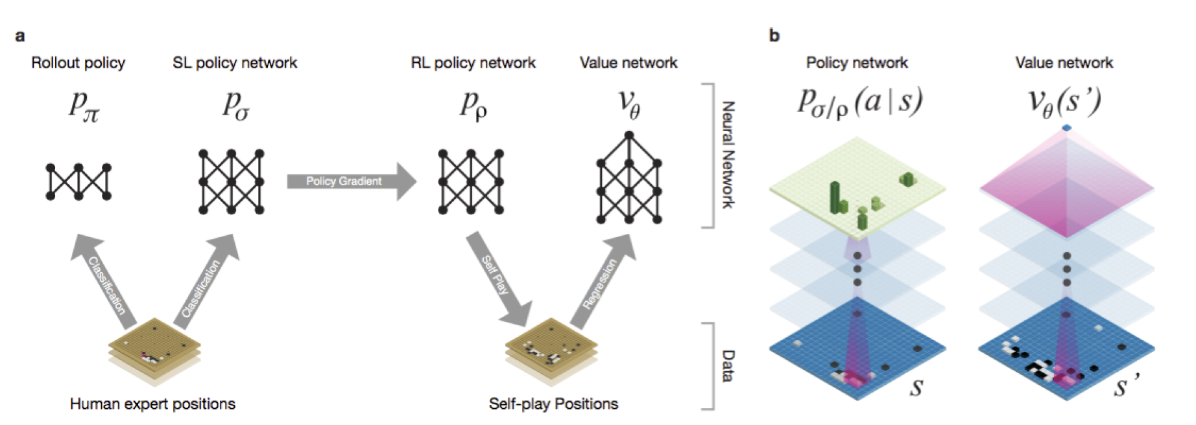
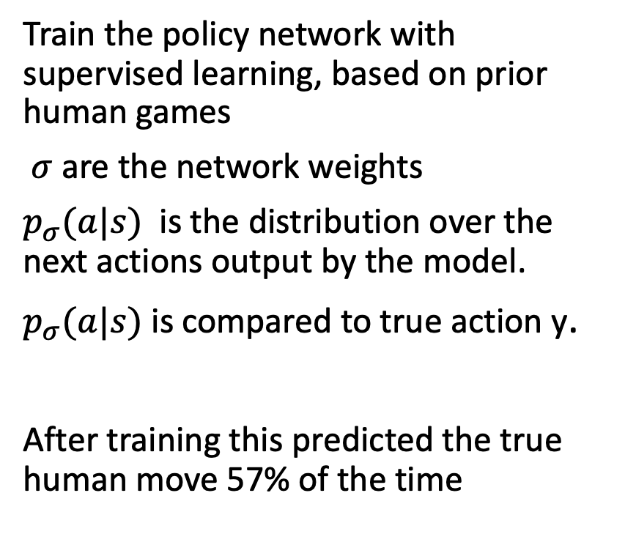
The parts of Alpha Go
Train the policy network with supervised learning, based on prior human games
$σ$are the network weights
$p_{σ}(a|s)$ is the distribution over the next actions output by the model.
$p_{σ}(a|s)$ is compared to true action y.
After training this predicted the true human move 57% of the time
Silver, David, et al. "Mastering the game of Go with deep neural networks and tree search." nature 529.7587 (2016): 484-489
Notes:
A fast rollout policy p and supervised
learning (SL) policy network p are trained to predict human expert moves in a data-set of
positions. A reinforcement learning (RL) policy network p is initialised to the SL policy network,
and is then improved by policy gradient learning to maximize the outcome (i.e. winning more
games) against previous versions of the policy network. A new data-set is generated by playing
games of self-play with the RL policy network. Finally, a value network v is trained by regression
to predict the expected outcome (i.e. whether the current player wins) in positions from the selfplay
data-set.

Slide 58
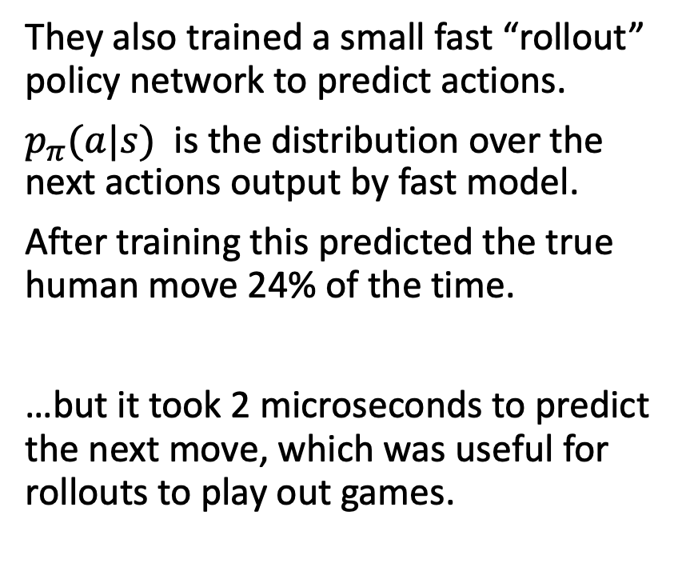
The parts of Alpha Go
They also trained a small fast “rollout” policy network to predict actions.
$p_{π}(a|s)$ is the distribution over the next actions output by fast model.
After training this predicted the true human move 24% of the time.
…but it took 2 microseconds to predict the next move, which was useful for rollouts to play out games.
Silver, David, et al. "Mastering the game of Go with deep neural networks and tree search." nature 529.7587 (2016): 484-489
Notes:
A fast rollout policy p and supervised
learning (SL) policy network p are trained to predict human expert moves in a data-set of
positions. A reinforcement learning (RL) policy network p is initialised to the SL policy network,
and is then improved by policy gradient learning to maximize the outcome (i.e. winning more
games) against previous versions of the policy network. A new data-set is generated by playing
games of self-play with the RL policy network. Finally, a value network v is trained by regression
to predict the expected outcome (i.e. whether the current player wins) in positions from the selfplay
data-set.

Slide 59
The parts of Alpha Go
Silver, David, et al. "Mastering the game of Go with deep neural networks and tree search." nature 529.7587 (2016): 484-489
Notes:
A fast rollout policy p and supervised
learning (SL) policy network p are trained to predict human expert moves in a data-set of
positions. A reinforcement learning (RL) policy network p is initialised to the SL policy network,
and is then improved by policy gradient learning to maximize the outcome (i.e. winning more
games) against previous versions of the policy network. A new data-set is generated by playing
games of self-play with the RL policy network. Finally, a value network v is trained by regression
to predict the expected outcome (i.e. whether the current player wins) in positions from the selfplay
data-set.

Slide 60
The parts of Alpha Go
Once they had a trained policy network, they engaged in self-play.
Make 2 copies of the network.
They play.
Apply reinforcement learning to the winner.
Thereafter, always play vs a previous version of the RL network.
Learn as you go…
Silver, David, et al. "Mastering the game of Go with deep neural networks and tree search." nature 529.7587 (2016): 484-489
Notes:
A fast rollout policy p and supervised
learning (SL) policy network p are trained to predict human expert moves in a data-set of
positions. A reinforcement learning (RL) policy network p is initialised to the SL policy network,
and is then improved by policy gradient learning to maximize the outcome (i.e. winning more
games) against previous versions of the policy network. A new data-set is generated by playing
games of self-play with the RL policy network. Finally, a value network v is trained by regression
to predict the expected outcome (i.e. whether the current player wins) in positions from the selfplay
data-set.

Slide 61
The parts of Alpha Go
Then….they generated 30 million game states from self play and taught a Value network to estimate the value of every one of those states, based on the outcome of the game the state came from.
Silver, David, et al. "Mastering the game of Go with deep neural networks and tree search." nature 529.7587 (2016): 484-489
Notes:
A fast rollout policy p and supervised
learning (SL) policy network p are trained to predict human expert moves in a data-set of
positions. A reinforcement learning (RL) policy network p is initialised to the SL policy network,
and is then improved by policy gradient learning to maximize the outcome (i.e. winning more
games) against previous versions of the policy network. A new data-set is generated by playing
games of self-play with the RL policy network. Finally, a value network v is trained by regression
to predict the expected outcome (i.e. whether the current player wins) in positions from the selfplay
data-set.

Slide 62
Monte Carlo Tree Search (MCTS)
Select the edge with maximum action-value Q , plus a bonus u(P) that depends on a stored prior probability P for that edge
Silver, David, et al. "Mastering the game of Go with deep neural networks and tree search." nature 529.7587 (2016): 484-489

Slide 63
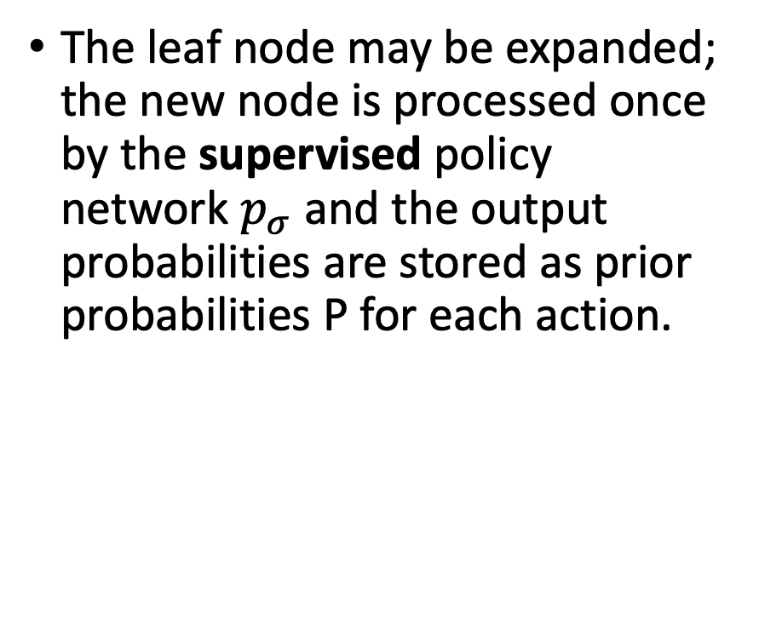
Monte Carlo Tree Search (MCTS)
The leaf node may be expanded; the new node is processed once by the supervised policy network $p_{σ}$ and the output probabilities are stored as prior probabilities P for each action.
Silver, David, et al. "Mastering the game of Go with deep neural networks and tree search." nature 529.7587 (2016): 484-489

Slide 64
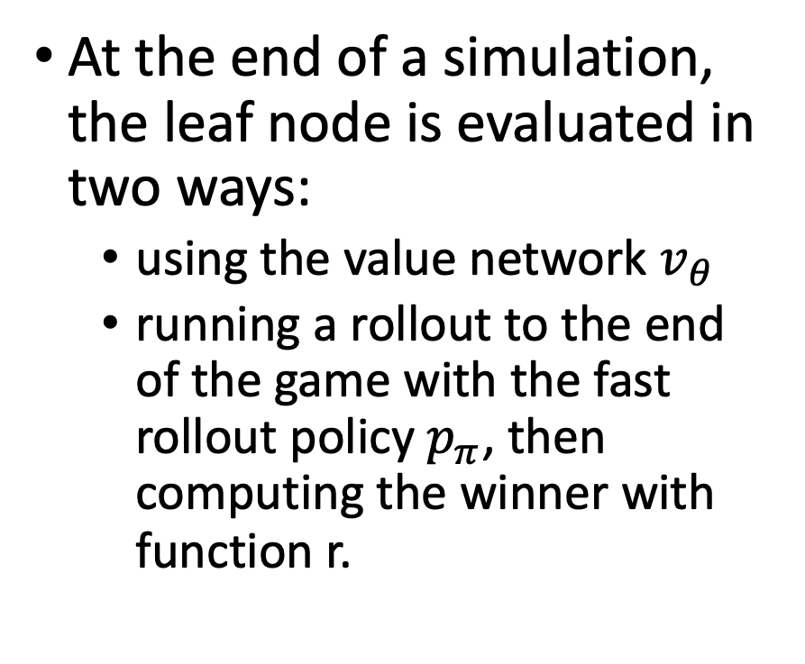
Monte Carlo Tree Search (MCTS)
At the end of a simulation, the leaf node is evaluated in two ways:
using the value network $v_{θ}$
running a rollout to the end of the game with the fast rollout policy $p_{π}$, then computing the winner with function r.
Silver, David, et al. "Mastering the game of Go with deep neural networks and tree search." nature 529.7587 (2016): 484-489

Slide 65
Monte Carlo Tree Search (MCTS)
Action-values Q are updated to track the mean value of all evaluations r() and v() in the subtree below that action.
Silver, David, et al. "Mastering the game of Go with deep neural networks and tree search." nature 529.7587 (2016): 484-489

Slide 66
Do they really need to learn from humans?
Alpha0 jettisoned all the human-trained supervised learning
It learns exclusively from self play
How well does that work?
Silver, D., Hubert, T., Schrittwieser, J., Antonoglou, I., Lai, M., Guez, A., ... & Lillicrap, T. (2018). A general reinforcement learning algorithm that masters chess, shogi, and Go through self-play. Science, 362(6419), 1140-1144.

Slide 67
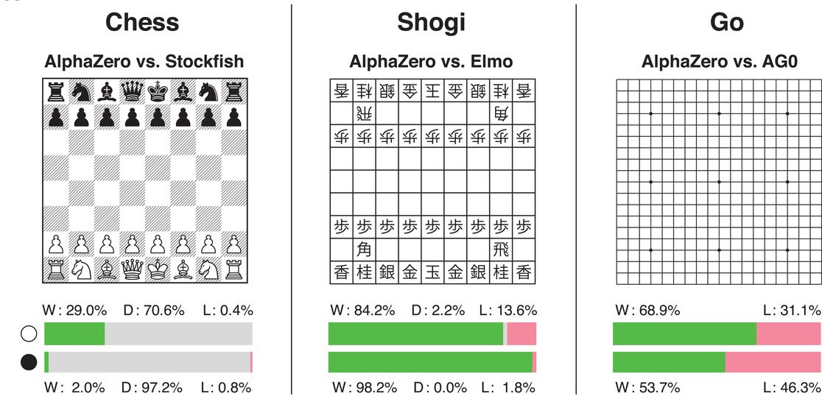
Alpha0 is a general game winner
Silver, D., Hubert, T., Schrittwieser, J., Antonoglou, I., Lai, M., Guez, A., ... & Lillicrap, T. (2018). A general reinforcement learning algorithm that masters chess, shogi, and Go through self-play. Science, 362(6419), 1140-1144.

Slide 68
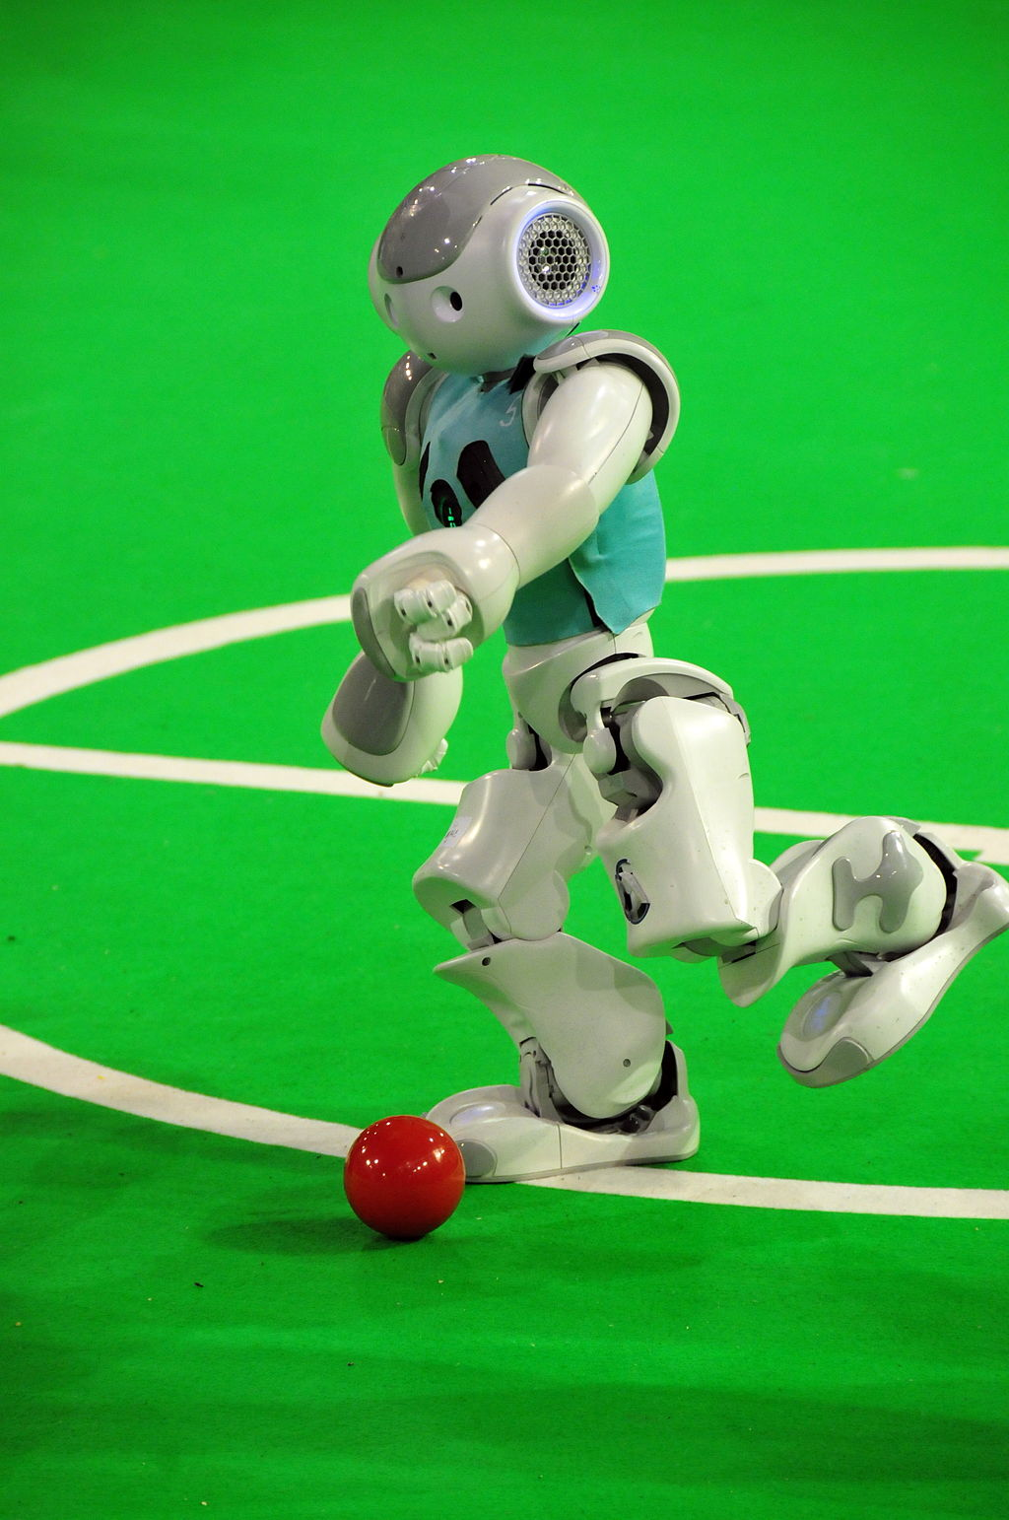
Learning to Walk
RoboCup legged league
Walking quickly is a big advantage
Robots have a parameterized gait controller
Multiple REAL VALUED parameters
Controls step length, height, etc.
Robots walk across soccer pitch and are timed
Reward is a function of the time taken
Image courtesy of: Ralf Roletschek
https://www.wikidata.org/wiki/Q15080600

